Slide 1

UNIVERSITY INSTITUTE OF ENGINEERING
COMPUTER SCIENCE ENGINEERING
Computer Vision (CST-422)
Prepared By : Payal Thakur(E12720)
Topic: Preparing your images for classification
DISCOVER . LEARN . EMPOWER

Slide 2
Preparing Images for Classification
Classification is defined as the process of recognition, understanding, and grouping of images into preset categories.
Classification is a form of “pattern recognition,”.
The classification algorithms applied to the training data find the same pattern (similar number sequences, words or sentiments, and the like) in future data sets.

Slide 3
Steps Involved Image Preparation
1. Data Collection
Gather a diverse and representative dataset of images for each class you want to classify.
Ensure that the images are of good quality, appropriately labeled, and cover different variations within each class.
Define the Objectives: Clearly define the objectives of your image processing task. Determine the specific types of images you need to collect and the problem you aim to solve. This could include tasks like object detection, image classification, image segmentation, or any other specific image processing task.
Data Sources: Identify potential sources for collecting images. This can include publicly available datasets, online repositories, domain-specific websites, social media platforms, or even capturing your own images. Ensure that the data sources align with your objectives and provide images relevant to your specific problem.

Slide 4
Steps Involved Image Preparation
1. Data Collection
Define the Objectives: Clearly define the objectives of your image processing task. Determine the specific types of images you need to collect and the problem you aim to solve. This could include tasks like object detection, image classification, image segmentation, or any other specific image processing task.
Data Sources: Identify potential sources for collecting images. This can include publicly available datasets, online repositories, domain-specific websites, social media platforms, or even capturing your own images. Ensure that the data sources align with your objectives and provide images relevant to your specific problem.

Slide 5
Steps Involved Image Preparation
2. Resize and Crop:
Normalize the size of your images to a consistent resolution.
Resizing is important to ensure that all images have the same dimensions, which is often required by machine learning algorithms.
You can also consider cropping images to focus on the relevant parts and remove any unnecessary background.

Slide 6
Steps Involved Image Preparation
2. Resize and Crop: Resizing:
Resizing refers to changing the dimensions (width and height) of an image.
It is commonly used to ensure that all images in a dataset have a consistent size. Here are a few points to be kept in mind:
a) Aspect Ratio: When resizing an image, it's important to maintain the aspect ratio to prevent distortion.
The aspect ratio represents the proportional relationship between the width and height of an image.

Slide 7
Steps Involved Image Preparation
2. Resize and Crop: Resizing:
b) Interpolation: Resizing involves interpolating the pixel values to fit the new dimensions. Common interpolation methods include nearest-neighbor, bilinear, and bicubic. The choice of interpolation method depends on the specific requirements of the task.
c) Downsampling and Upsampling: Resizing can involve downsampling (reducing image size) or upsampling (increasing image size). Downsampling can lead to loss of information, while upsampling can result in the creation of new pixel values.

Slide 8
Steps Involved Image Preparation
2. Resize and Crop: Cropping:
Cropping involves selecting a specific region of interest (ROI) from an image while discarding the rest. It can be used for various purposes, such as removing irrelevant or noisy background, focusing on specific objects or regions, or creating new training samples through data augmentation. Here are some considerations:
a) ROI Selection: The selection of the ROI depends on the specific task and the desired information in the image. It can be done manually or automatically using techniques like object detection or image segmentation.
b) Aspect Ratio and Proportions: When cropping an image, it's important to maintain the aspect ratio or adjust it as needed. Cropping can be performed uniformly on all sides or selectively on specific sides, depending on the desired composition.
c) Augmentation: Cropping is commonly used as a data augmentation technique to increase the diversity of training samples. By randomly cropping different regions of an image, additional training examples can be generated to improve the model's robustness.
d) Padding: When cropping an image, padding can be applied to maintain the output size, especially when the desired ROI extends beyond the original image boundaries. Padding involves adding extra pixels around the image by duplicating existing pixels or filling with specific values.

Slide 9
Steps Involved Image Preparation
2. Resize and Crop: Cropping:
c) Augmentation: Cropping is commonly used as a data augmentation technique to increase the diversity of training samples. By randomly cropping different regions of an image, additional training examples can be generated to improve the model's robustness.
d) Padding: When cropping an image, padding can be applied to maintain the output size, especially when the desired ROI extends beyond the original image boundaries. Padding involves adding extra pixels around the image by duplicating existing pixels or filling with specific values.

Slide 10
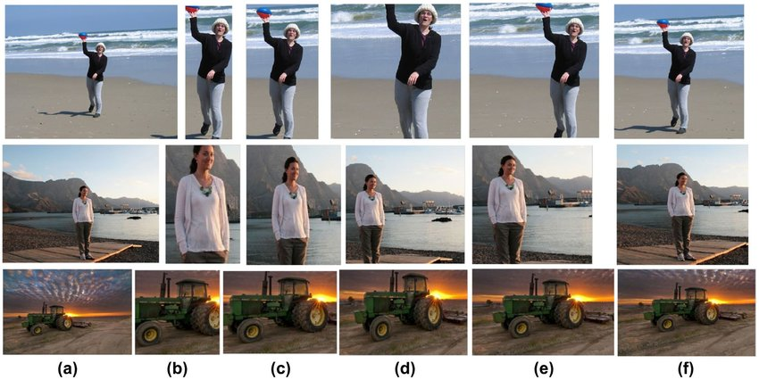
Steps Involved Image Preparation

Slide 11
Steps Involved Image Preparation
3. Image Enhancement :
Used to improve the visual quality, clarity, and interpretability of images before they are fed into machine learning algorithms.
The goal is to enhance important image features while reducing noise and other artifacts that may hinder the performance of the machine learning models.
Apply basic preprocessing techniques to enhance the quality of your images.
These techniques may include adjusting brightness, contrast, and color balance.
Be careful not to introduce any bias or distortions that could affect the classification accuracy.

Slide 12
Steps Involved Image Preparation
3. Image Enhancement :
Contrast Enhancement: Adjusting the contrast of an image helps to improve the visibility of details. Techniques like histogram equalization, adaptive histogram equalization (AHE), and contrast stretching can be employed to enhance the dynamic range of pixel intensities.
Sharpening: Sharpening techniques emphasize the edges and fine details in an image, making it appear clearer. Unsharp masking and Laplacian sharpening are commonly used methods to enhance image sharpness.

Slide 13
Steps Involved Image Preparation
3. Image Enhancement :
Deblurring: Blurred images can be enhanced using deconvolution techniques, which aim to recover the original sharp image by estimating the blur kernel. Methods like Wiener deconvolution, blind deconvolution, or iterative deconvolution can be used to address various types of blurring.
Super-Resolution: Super-resolution techniques aim to enhance the resolution and details of low-resolution images. By employing deep learning models or advanced algorithms, it is possible to generate high-resolution images from low-resolution inputs.
Color Correction: Correcting color imbalances and improving color appearance can be crucial for certain machine learning tasks. Techniques like color histogram equalization, color correction using reference images, or color transfer methods can be used to enhance the color fidelity of images.

Slide 14
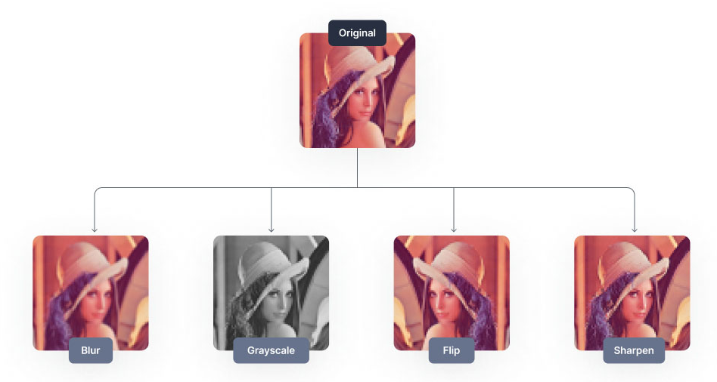
Steps Involved Image Preparation

Slide 15
Steps Involved Image Preparation
4. Noise Reduction :
If your images have noise or unwanted artifacts, consider applying noise reduction techniques like smoothing filters or denoising algorithms.
It helps improve the quality and reliability of the input data, allowing the machine learning model to make more accurate predictions or extract meaningful features from the images.
There are several approaches to noise reduction in image processing, few commonly used techniques are:

Slide 16
Steps Involved Image Preparation
4. Noise Reduction :
Gaussian Blur: This technique applies a Gaussian filter to the image, which essentially blurs the image and reduces high-frequency noise. The filter replaces each pixel's value with a weighted average of its neighboring pixels. Adjusting the size of the filter kernel allows for controlling the amount of blurring.
Median Filtering: In median filtering, a sliding window is moved across the image, and the pixel under the window is replaced with the median value of the pixels within the window. This approach is effective in removing salt-and-pepper noise, where individual pixels are corrupted with either very bright or very dark values.

Slide 17
Steps Involved Image Preparation
4. Noise Reduction :
Non-local Means Denoising: Non-local means (NLM) denoising is a popular technique that exploits the redundancy present in natural images. It works by finding similar patches in the image and using them to estimate the noise-free value of a particular patch. NLM denoising is effective in removing random noise while preserving image details.
Wavelet Denoising: Wavelet denoising is based on the idea of decomposing an image into different frequency bands using wavelet transforms. The noise is assumed to be concentrated in high-frequency wavelet coefficients, while the important image features are present in low-frequency coefficients. By thresholding or shrinking the high-frequency coefficients, the noise can be reduced while preserving the image details.

Slide 18
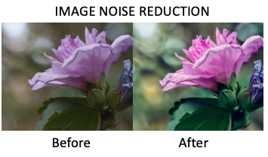
Steps Involved Image Preparation

Slide 19
Steps Involved Image Preparation
5. Normalization :
It refers to the process of transforming and standardizing pixel values in an image to a common scale. It is performed on image data to improve the performance and convergence of machine learning algorithms.
Normalization ensures that each feature (pixel) contributes equally to the learning process, preventing any particular feature from dominating the model's training.
Normalize the pixel values of your images to a common range.
This step helps in reducing the effect of lighting variations and ensures that the input to your classification algorithm is consistent.
Few normalization techniques are:

Slide 20
Steps Involved Image Preparation
5. Normalization :
Min-Max Normalization: This method scales the pixel values to a specific range, typically between 0 and 1. It is achieved by subtracting the minimum pixel value from each pixel and then dividing by the difference between the maximum and minimum pixel values.
Z-Score Normalization: Also known as standardization, this method transforms the pixel values to have zero mean and unit variance. It involves subtracting the mean of the pixel values and dividing by the standard deviation.

Slide 21
Steps Involved Image Preparation
5. Normalization :
Decimal Scaling: In this method, the pixel values are divided by a scaling factor that is a power of 10. The scaling factor is determined based on the maximum absolute pixel value in the image, ensuring that all pixel values fall within a specific range.
Unit Vector Normalization: This method normalizes the pixel values to have a unit magnitude (length) by dividing each pixel by the L2 norm (Euclidean norm) of the entire image. It ensures that the pixel values lie on the surface of a hypersphere.

Slide 22
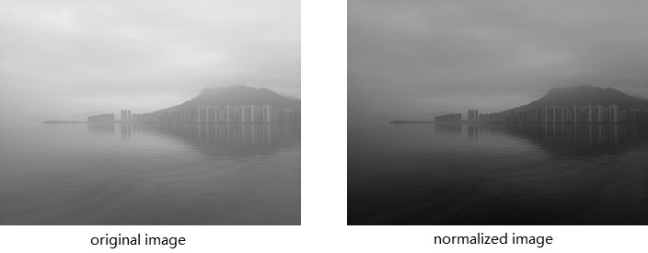
Steps Involved Image Preparation

Slide 23
Steps Involved Image Preparation
6. Augmentation :
Image augmentation is a technique that artificially expands your dataset by applying various transformations like rotation, flipping, scaling, or adding noise.
Augmentation can help improve the generalization capability of your classifier and reduce overfitting.

Slide 24
Steps Involved Image Preparation
6. Augmentation :
Common image augmentation techniques used in machine learning:
Horizontal/Vertical Flipping: The image is flipped horizontally or vertically, simulating mirror images.
Rotation: The image is rotated by a certain angle, such as 90 degrees or a random angle, to introduce rotational invariance.
Translation: The image is shifted horizontally or vertically by a certain distance, simulating changes in position.
Scaling: The image is scaled up or down by a certain factor, simulating changes in the size of objects in the image.

Slide 25
Steps Involved Image Preparation
6. Augmentation :
Shearing: The image is skewed along a certain axis, introducing distortions.
Zooming: A portion of the image is zoomed in or out, simulating changes in perspective.
Noise Injection: Random noise is added to the image, simulating variations in lighting conditions or sensor noise.
Brightness/Contrast Adjustment: The brightness or contrast of the image is modified, simulating changes in lighting conditions.
Color Jittering: The color values of the image are randomly modified, simulating changes in color distribution.

Slide 26
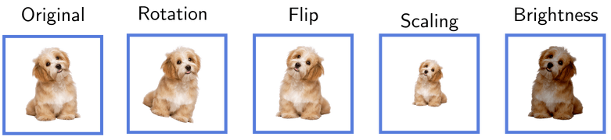
Steps Involved Image Preparation

Slide 27
Steps Involved Image Preparation
7. Split into Training and Validation Sets Augmentation :
Divide your dataset into training and validation sets.
The training set is used to train your classification model, while the validation set is used to evaluate the model's performance and tune hyperparameters.
Ensure that the images are randomly split while maintaining a balanced distribution across classes.
The typical split ratio is around 70-80% for training and 20-30% for validation, depending on the size of your dataset.

Slide 28
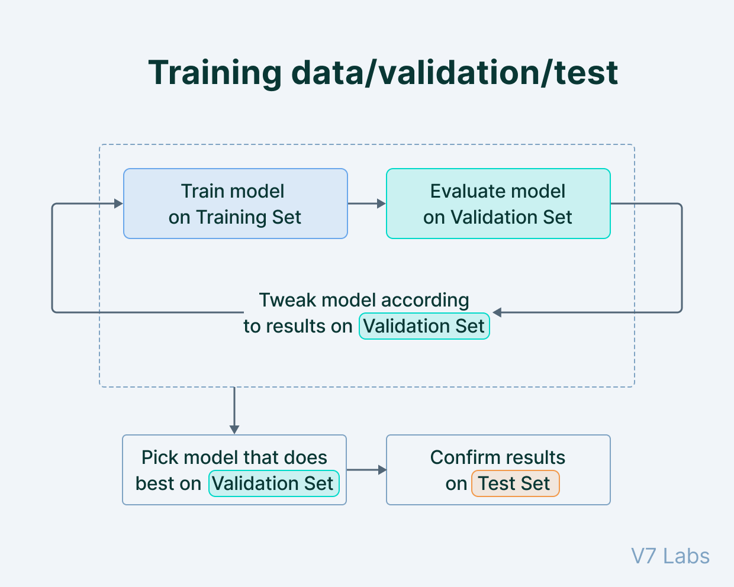
Steps Involved Image Preparation

Slide 29
References:-
Books:-
"Introduction to Computer Vision" by David Forsyth and Jean Ponce. Chapter 6: Features and Descriptors provides an in-depth explanation of feature detection, extraction, and matching algorithms.
Computer Vision: Algorithms and Applications" by Richard Szeliski. Chapter 4: Image Features covers various feature detection, extraction, and matching techniques.
Video Links
"Feature Detection and Description" by Stanford University - Computer Vision (CS231n). Available on YouTube: https://www.youtube.com/watch?v=H-HVZJ7kGI0
"Feature Matching and Homography" by University of Washington - Computer Vision (CSE 576). Available on YouTube: https://www.youtube.com/watch?v=uvSCXyYpG9k
"Introduction to Feature Detection and Matching" by OpenCV. Available on YouTube: https://www.youtube.com/watch?v=AWoG8vdw4pA

Slide 30
THANK YOU
For queries
Email: payal.e12720@cumail.in

